Slide 1
University American College Skopje
Course: Business Computer Applications
Business Software Applications
Marija Stanojeska, PhD

Slide 2
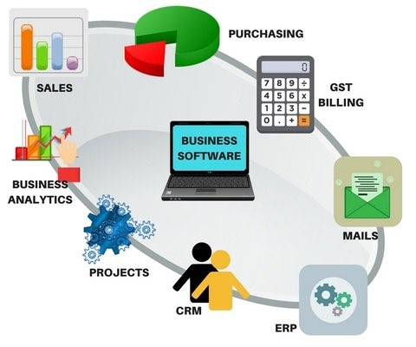
Based on the textbook:
Microsoft Office Inside Out (Office 2021 and Microsoft 365), J. Habraken, Pearson Education, Inc., 2022.

Slide 3
Business Intelligence

Slide 4
What is Business Intelligence?
In today's business world, data-driven decision-making is essential for success. Business Intelligence (BI) has become a fundamental tool for organizations seeking a better understanding of their operations, customers, and growth opportunities.
Business Intelligence refers to the technologies, processes, and tools that help organizations collect, analyze, and present business data to support better decision-making. BI involves the use of various data analysis techniques, reporting, and visualization tools to transform raw data into meaningful insights. It’s increasingly important for businesses to have a clear view of all their data to stay competitive, which is where business intelligence (BI) tools come in. After all, a vast of all businesses already use BI tools, and projections show continued growth in coming years. Essentially, Business Intelligence enables the business to make intelligent, fact-based decisions.
Business intelligence processes analyze data and deliver actionable insights that help managers and executives make informed decisions.
BI involves:
  Collecting information from internal and external sources.
  Preparing data for analysis.
  Running queries.
  Creating intuitive visualizations, reports and dashboards.

Slide 5
Business Intelligence concept
Extract Raw Data
The first component of a BI solution is data from sales records, profit and loss statements, salary details and more. An organization’s data exists in various systems, including CRM, ERP, flat files and more. Due to this fragmentation, BI solutions come with robust connectors to centralize everything for advanced analysis.
Consolidate Information
A data warehouse integrates different databases to create relationships. Data flows into the warehouse from various sources, including transactional systems, relational databases and more.
Access and Analyze Data
Once the data consolidates in a single location, it is vital to make sense of it. BI solutions access the information, interpret it for trends and patterns, and present it intuitively.
Create Dashboards and Reports
Dashboards and reports take complex, unintelligible information and output it as digestible patterns, trends and insights. These tools facilitate collaboration within the organization to share findings and discoveries.

Slide 6
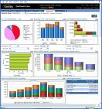


Business Intelligence process
Data Integration Data Analysis
Data Mining
Data Warehousing
Reporting
Inform a Decision
Storage of large volumes of structured and unstructured data.
Combining data from various sources to create a unified view. Using tools to analyze and interpret data. Extracting patterns and trends from large datasets.
Creating reports and dashboards for visualization.
Decisions are Fact-based and Data-driven.

Slide 7
Business Intelligence Importance
Provide Data-driven Insights
The above BI concepts help organizations enhance inside and outside communications, solve problems, analyze data and ensure business profitability with valuable insights crafted from internal data.
Set Benchmarks
Set actionable goals and benchmarks to drive performance. Formulate effective strategies to achieve predetermined objectives. Evaluate progress through robust KPIs to boost revenue and ROI.
Predict Trends
Predict trends and patterns accurately to mitigate risks and capitalize on advantages before your competitors.
Create Powerful Visuals
Develop visualizations to convey a data story. Extrapolate usable information from complex datasets and present them to stakeholders and team members for discussions and planning.

Slide 8
Business Intelligence Application
Analyze Sales Cycle
Leverage sales analytics to see sales representative performance. Measure who is succeeding and failing while improving existing processes within the organization. Use sales dashboards to analyze the sales cycle and compare manager performance.
Identify Customer Behavior
Analyze customer activity on your website and how they respond to marketing campaigns. Examine which customer acquisition channels are driving revenue. Invest in high-performing channels to attract profitable customers.
Plan Marketing Activities
Force predictive analytics to identify efficient campaigns. Measure how different campaigns perform based on predetermined objectives.
Boost Customer Service Experience
Display customer service KPIs, including average response times, to boost customer service, internal training and development initiatives.

Slide 9
BI and integration of CRM and ERP
Two key systems in Business Intelligence for strategic information are:
  Customer Relationship Management (CRM)
  Enterprise Resource Planning (ERP)
The integration of CRM and ERP can enhance a company's business intelligence. It can empowers business intelligence by providing a more complete and accurate view of operations and customer relationships. Companies that leverage this integration can make more informed decisions, optimize their business processes, and remain competitive in an ever-changing market. Investing in this technology can result in a significant return as organizations harness their data to drive growth and efficiency.

Slide 10
Customer Relationship Management

Slide 11
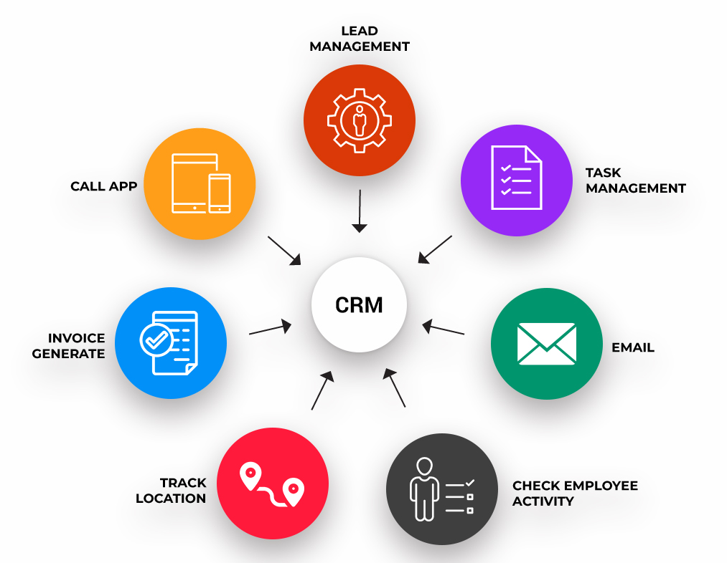
CRM (Customer Relationship Management)
Customer Relationship Management (CRM) is a strategic approach that businesses use to manage and analyze interactions with current and potential customers throughout the customer lifecycle. The goal of CRM is to improve customer satisfaction, loyalty, and ultimately, drive business growth. This system focuses on customer relationship management. It allows businesses to track and manage customer interactions throughout their lifecycle, from initial contact to sales and ongoing support. CRM involves not only technology but also processes and a customer-centric mindset. CRM stores customer data, sales tracking, interaction histories, and preferences, providing a complete view of customer relationships.

Slide 12
CRM components
Customer satisfaction
Measures a customer’s perception of the quality of a product, service, or company, incorporating product engagement and many other factors. Customer satisfaction is an essential component of CRM because it is a purchasing guideline for the company and the customer. If a customer is not satisfied with the result of their purchase, they are more likely to purchase from another company.
Customer loyalty
It is the measure of repeat sales and referrals. This measurement depends on how often a customer purchases from one particular company versus others that may be similar or better suited to their needs throughout the customer journey. Loyal customers are more likely to be satisfied with their purchase and recommend the product to others. Thus, it is essential because it provides a consistent source of revenue for the company as product engagement has a higher success rate as customers are familiar with and satisfied with products from a specific company.
Profitability
It measures how much profit (or loss) a company makes during its operation. Calculate it by total revenue minus total costs. Profit is significant because it allows companies to continue operations and stay profitable to grow and expand. Without profit, companies would eventually be unable to pay employees, suppliers, or taxes and eventually go out of business due to a lack of funds.

Slide 13
CRM components (cont.)
Customer Retention
Customer retention measures how many customers remain loyal to one company over time. Retained customers are less expensive for companies than new customers who have to go through research and development, marketing campaigns, and promotion costs all over again for new customers. They are also more profitable for companies because they do not have to spend money acquiring them again after they have already purchased from the company once before.
Marketing
CRM plays a crucial role in marketing as it involves promoting and advertising your business to attract new customers. By analyzing the behavior of potential customers, CRM helps enhance advertising strategies for greater effectiveness. Marketing consists of different sub-components that vary depending on your business. One of the sub-components of marketing is customer service. The purpose of CRM is to gather consumer information and use it to enhance their experience. By connecting all channels onto a single platform, CRM helps companies personalize their products and services, including personalized marketing messages.
Business Reporting
The final component of CRM is business reporting, which provides users with reports containing visual elements to track data over time. By comparing historical data and forecasting future performance, users can gain insights into their business operations. Users can export data to other systems using the report function. This helps CRM users track data and make forecasts for upcoming periods. Understanding how to create reports for CRM is crucial as reports can assist marketers and customer support departments in enhancing their processes, while also offering valuable insights to business investors regarding the company’s health and revenue trends. The reports should be readily available and viewable from any perspective. By having the information centralized, executives can conveniently oversee multiple departments at once.

Slide 14
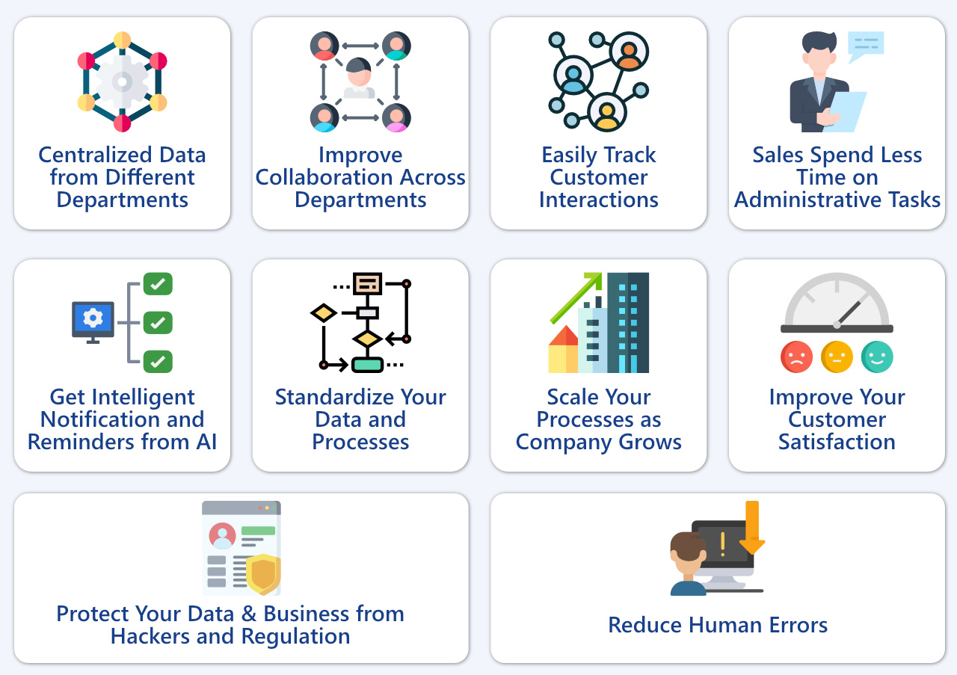
CRM Benefits

Slide 15
The key features of CRM software
Contact and Lead Management
CRM software provides a centralized database for storing and managing customer contact information. It helps track leads, categorize them, and manage their progression through the sales pipeline.
Sales Automation
Streamlines sales processes by automating tasks such as lead assignment, opportunity management, and follow-ups. Allows sales teams to track and manage deals, forecast sales, and prioritize prospects.
Marketing Automation
Enables the planning, execution, and tracking of marketing campaigns. Automates email marketing, lead nurturing, and other marketing processes to engage prospects and customers.
Customer Service and Support
Provides tools for managing customer support tickets, inquiries, and service requests. Helps track and resolve customer issues efficiently, improving overall customer satisfaction.
Analytics and Reporting
Offers reporting and analytics features to track key performance indicators (KPIs) related to sales, marketing, and customer service. Provides insights into customer behavior, preferences, and trends.
Integration Capabilities
Integrates with other business systems, such as ERP (Enterprise Resource Planning) and BI (Business Intelligence), to ensure a seamless flow of information across the organization. Enables a holistic view of customer data by connecting with various data sources.

Slide 16
The key features of CRM software (cont.)
Workflow Automation
Automates routine tasks and workflows to increase efficiency. Customizable workflows align with specific business processes and requirements.
Mobile CRM
Many CRM solutions offer mobile applications, allowing sales and service teams to access and update customer information on the go. Supports remote work and facilitates real-time communication.
Social CRM
Integrates with social media platforms to gather insights into customer sentiment and engagement. Monitors social media channels for customer interactions and feedback.
Customization and Scalability
Allows businesses to customize the CRM system to match their unique processes and needs. Scales with the growth of the business, accommodating an increasing volume of customer data and interactions.
Customer Loyalty Programs
Tracks and manages customer loyalty programs, reward systems, and incentive programs. Aids in retaining and nurturing long-term customer relationships.
Security and Data Privacy
Ensures the security of sensitive customer data. Complies with data privacy regulations to protect customer information.

Slide 17
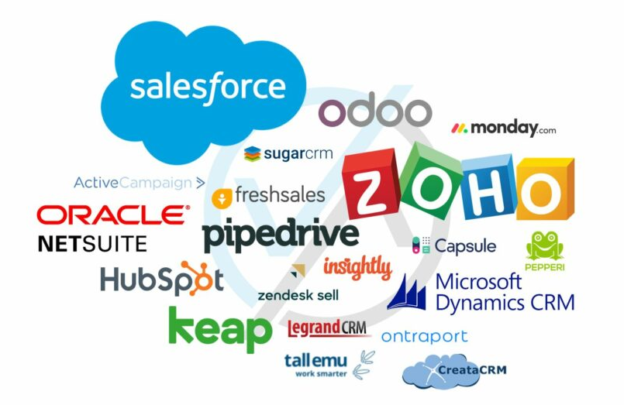
Popular CRM software
Popular CRM software includes solutions like Salesforce, Microsoft Dynamics 365, HubSpot CRM, Zoho CRM, and others. The choice of CRM software depends on the specific needs and scale of the business. Implementing a CRM system effectively can lead to improved customer relationships, streamlined processes, and better-informed business decisions.

Slide 18
Microsoft Dynamics 365
Dynamics 365 is a portfolio of intelligent business applications that delivers superior operational efficiency and breakthrough customer experiences enabling businesses to become more agile and reduce complexity without increasing costs.
The latest version of Microsoft Dynamics 365 is Microsoft Copilot for Dynamic 365.
2023 Release Wave 1 Highlight
Enrich the employee experience
Microsoft introduced Microsoft Copilot for Dynamics 365, the world’s first AI copilot natively built for CRM and ERP. Since then, more than 130,000 organizations have experienced copilot capabilities in Microsoft Dynamics 365 and Microsoft Power Platform firsthand. In fact, a survey revealed that 70 percent of the Copilot users were more productive, 73 percent could complete tasks faster, and 68 percent of users improved the quality of their work.
Close more deals and personalize customer journeys by using AI to deliver real-time insights and recommendations to sellers and marketers within the flow of work.
With Microsoft Sales Copilot and Copilot in Customer Insights, your teams can boost efficiency with automated summaries and content creation and break down barriers in the customer journey by democratizing access to customer data.

Slide 19
Enterprise Resource Planning

Slide 20
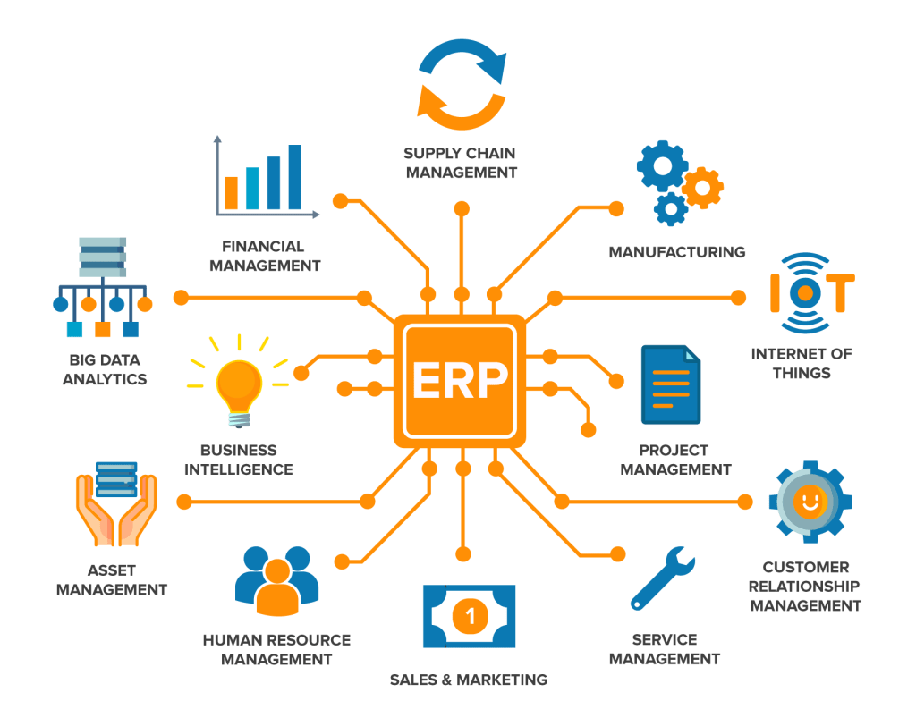
Enterprise Resource Planning (ERP)
Enterprise resource planning (ERP) is a type of software system that helps organizations automate and manage core business processes for optimal performance. ERP software coordinates the flow of data between a company’s business processes, providing a single source of truth and streamlining operations across the enterprise. It’s capable of linking a company’s financials, supply chain, operations, commerce, reporting, manufacturing and human resources activities on one platform. Companies that include human resource management (HRMS), customer relationship management (CRM) and ecommerce capabilities will see even greater benefits.

Slide 21
The benefits of ERP
ERP is generally seen as having the potential to very significantly improve the performance of many companies in many different sectors. This is partly because of the very much enhanced visibility that information integration gives, but it is also a function of the discipline that ERP demands.
The generally accepted benefits of ERP are usually held to be the following:
Because software communicates across all functions, there is absolute visibility of what is happening in all parts of the business.
The discipline of forcing business-process-based changes is an effective mechanism for making all parts of the business more efficient.
There is better ‘sense of control’ of operations that will form the basis for continuous improvement.
It enables far more sophisticated communication with customers, suppliers, and other business partners, often giving more accurate and timely information.
It is capable of integrating whole supply chains, including suppliers’ suppliers and customers’ customers.

Slide 22
ERP features
Integration
ERP integration is where an ERP software is connected with other applications and/or systems, with a goal to share data across these systems to improve productivity and insights. ERP systems are widely desired due to their ability to communicate with every application in the same ecosystem, or with other existing business software. This is beneficial for companies that have a variety of departments that need to connect with each other to avoid data duplication, repeat orders, or to avoid bottlenecks through a reduction in human error.
Automation
ERP automation integrations can help streamline processes across multiple departments and workflows. This is known as automation. This will help limit the required manual input and the time it takes for tasks to be completed. ERP software was originally developed to automate and link the processes of manufacturing operations - connecting departments by automating processes when certain steps or procedures became complete. With an ERP system, businesses processes can be automated and data kept in a centralized location - letting all users access it whenever needed.
Data Analysis
A business may use reports in order to answer questions about the strength of the business, but where does the data come from that is included on these reports? With every area of your business working under a unified ERP software, data on day-to-day operations can be shared across multiple entities and departments. Data can also be broadcast to multiple streams and allow companies to get real-time feedback for better decision-making.

Slide 23
ERP features (cont.)
Reporting
Reporting falls into the category of business intelligence tools designed to gather and sort historical data, create engaging visuals, and help analyze and report your findings. This feature can be called many different things or appear in may different forms. Examples include dashboards, data visualization, Gantt charts, pie charts, bar graphs, and more.
Reporting features occur in all types of business software, and reports can be created from nearly every type of data. This includes contact management, marketing success levels, sales activity, and lead management.
Financial Management
Financial management helps business track income and expenses and plan for growth. Commonly referred to as accounting, financial management modules are designed to help businesses make better spending decisions, create accurate financial reports, and manage assets. Because of this, accounting can be thought of as a subset of ERP software.
Sales and Marketing
Sales forecasting and providing sales quotes are a large part of your overall sales management and marketing efforts. Sales forecasting applications utilize historical data and sales funnel status tracking to create better projections for future sales. Sales quotes provide the ability to create, share, and track customer facing sales quotation documents.

Slide 24
ERP features (cont.)
Human Resources
While more commonly found as a standalone solution, most ERP software will include some level of human resource capabilities. These capabilities store employee information and automates tasks involving the people in your organization, such as employee scheduling, recruitment, and boosting employee productivity. HR features in an ERP software help your organization achieve it’s goals by allowing managers to better allocate employee time and resources to become a more productive and profitable business through better employee record keeping and increasing employee performance.
Supply Chain Management
Supply chain management (SCM) features within an ERP software help manufacturers, logistics providers, distributors, suppliers, and retailers manage the flow of goods and services between locations as efficiently and as cost-effectively as possible. This provides assistance from the acquisition of raw materials to a finished product being delivered to a customer.
Manufacturing
Manufacturing ERP features prevent machine downtime and improve upon the quality and efficiency of the products being created by your shop employees. More commonly known as MRP software, most manufacturing software tracks your purchased materials as well as current stock levels to ensure you always have what you need on-hand and don’t have to wait on materials to come in to start a new order.

Slide 25
CRM and ERP integration
The use of CRM features within an ERP software can lead to more effective identification of new prospects, reduce time and labor costs involved with managing customer information, and assist with customer upselling. This integration offers several key benefits for business intelligence:
Comprehensive Customer View
Combining CRM and ERP data provides a complete view of each customer. Sales and customer service teams can access financial information, purchase histories, outstanding payments, and contact details in one place. This enables them to make more informed decisions and personalize customer interactions.
Sales Prediction and Inventory Management
By linking real-time sales and inventory data, companies can more accurately forecast product demand. This helps them avoid overstock or inventory shortages, saving costs and improving customer satisfaction.
Deeper Financial Analysis
Integrating ERP financial data with CRM sales and marketing data allows financial teams to conduct deeper analysis. They can identify sales trends, assess product performance, and better understand how marketing strategies impact revenue and costs.
Business Process Automation
Workflow automation between CRM and ERP streamlines business processes. For example, sales information captured in CRM can automatically generate order records in ERP, eliminating the need for manual data entry and reducing errors.
Customized Reports and Dashboards
Integration allows for the creation of customized BI reports and dashboards that combine CRM and ERP data. This makes it easier to visualize key metrics in one place and enables executives to make data-driven decisions in real-time.

Slide 26
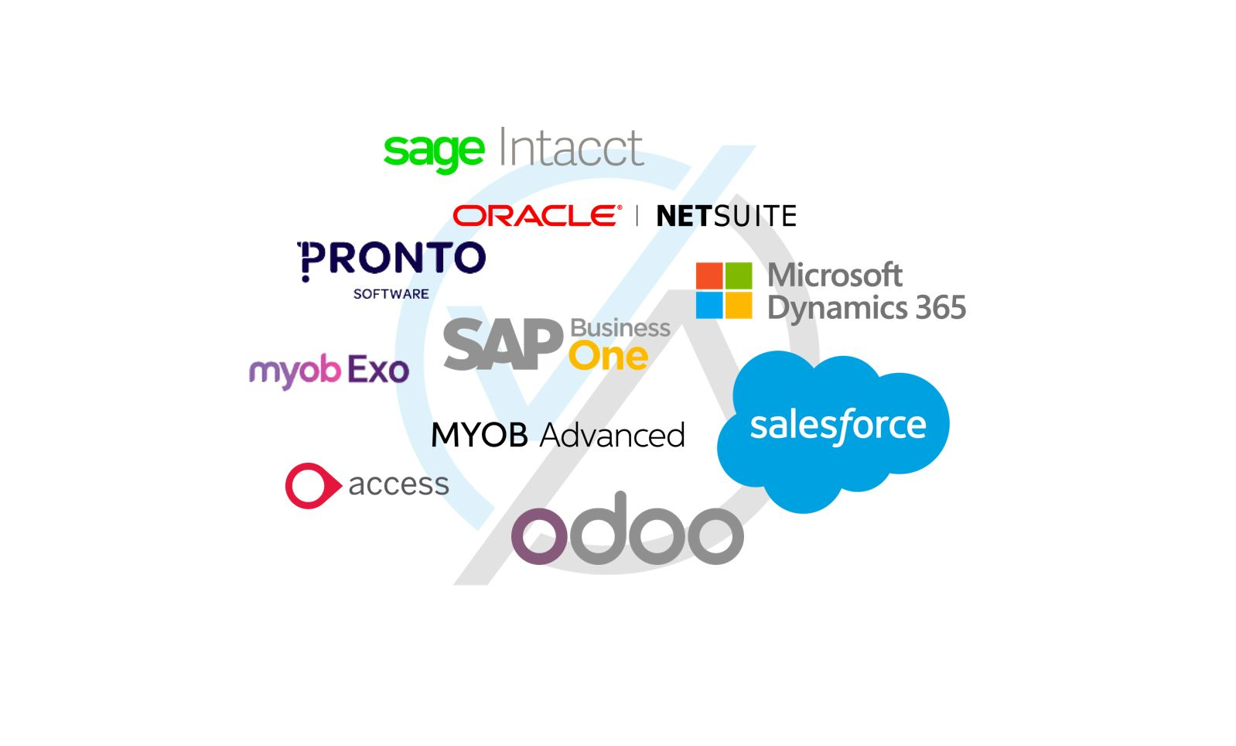
Popular ERM software
Some popular ERP tools that you may have heard of are Oracle NetSuite, Microsoft Dynamics 365, Oracle ERP Cloud, SAP, Sage Business Cloud X3, and/or Epicor ERP.

Slide 27
Cloud Computing

Slide 28
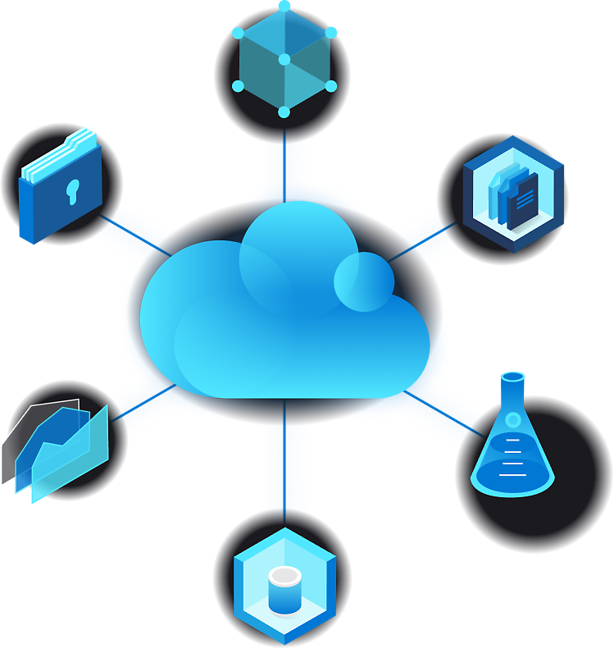
Cloud Computing
Simply put, cloud computing is the delivery of computing services - including servers, storage, databases, networking, software, analytics, and intelligence - over the internet (“the cloud”) to offer faster innovation, flexible resources, and economies of scale. You typically pay only for cloud services you use, helping you lower your operating costs, run your infrastructure more efficiently, and scale as your business needs change.

Slide 29
Types of Cloud Computing
Public cloud
Public clouds are owned and operated by third-party cloud service providers, which deliver computing resources like servers and storage over the internet. Microsoft Azure is an example of a public cloud. With a public cloud, all hardware, software, and other supporting infrastructure is owned and managed by the cloud provider. You access these services and manage your account using a web browser.
Private cloud
A private cloud refers to cloud computing resources used exclusively by a single business or organization. A private cloud can be physically located on the company’s onsite datacenter. Some companies also pay third-party service providers to host their private cloud. A private cloud is one in which the services and infrastructure are maintained on a private network.
Hybrid cloud
Hybrid clouds combine public and private clouds, bound together by technology that allows data and applications to be shared between them. By allowing data and applications to move between private and public clouds, a hybrid cloud gives your business greater flexibility and more deployment options and helps optimize your existing infrastructure, security, and compliance.

Slide 30
Types of cloud services
Software-as-a-service (SaaS)
Involves the licensure of a software application to customers. Licenses are typically provided through a pay-as-you-go model or on-demand. SaaS as a ready-to-use software application that you access over the internet. It's like using an app on your smartphone or a website in your browser. With SaaS, users don't need to worry about managing servers, databases, or infrastructure, just simply use the software as it is. This type of system can be found in Microsoft Office's 365 or Gmail.
Infrastructure-as-a-service (IaaS)
IaaS is like renting virtualized hardware (computers, storage, networking) from a provider.
It's similar to renting a computer in the cloud, where users have control over the operating system, software, and applications. Users are responsible for managing the virtual machines, operating systems, and applications you install on the provided infrastructure.
Popular examples of the IaaS system include IBM Cloud and Microsoft Azure.
Platform-as-a-service (PaaS)
PaaS is a bit like SaaS but for developers and app builders. It provides a platform with tools and services to help users develop, test, and deploy their applications. You can focus on writing code and building your app, while the PaaS provider manages the underlying infrastructure and services. This model includes platforms like Salesforce.com and Heroku.
Serverless computing
Overlapping with PaaS, serverless computing focuses on building app functionality without spending time continually managing the servers and infrastructure required to do so. The cloud provider handles the setup, capacity planning, and server management for you. Serverless architectures are highly scalable and event-driven, only using resources when a specific function or trigger occurs.

Slide 31
Cloud computing features
Create cloud-native applications
Quickly build, deploy, and scale applications - web, mobile, and API. Take advantage of cloud-native technologies and approaches, such as containers, microservices architecture, API-driven communication, and DevOps.
Store, back up, and recover data
Protect your data more cost-efficiently - and at massive scale - by transferring your data over the internet to an offsite cloud storage system that’s accessible from any location and any device.
Stream audio and video
Connect with your audience anywhere, anytime, on any device with high-definition video and audio with global distribution.
Deliver software on demand
Also known as software as a service (SaaS), on-demand software lets you offer the latest software versions and updates to customers - anytime they need, anywhere they are.
Test and build applications
Reduce application development cost and time by using cloud infrastructures that can easily be scaled up or down.
Analyze data
Unify your data across teams, divisions, and locations in the cloud. Then use cloud services, such as machine learning and artificial intelligence, to uncover insights for more informed decisions.
Embed intelligence
Use intelligent models to help engage customers and provide valuable insights from the data captured.

Slide 32
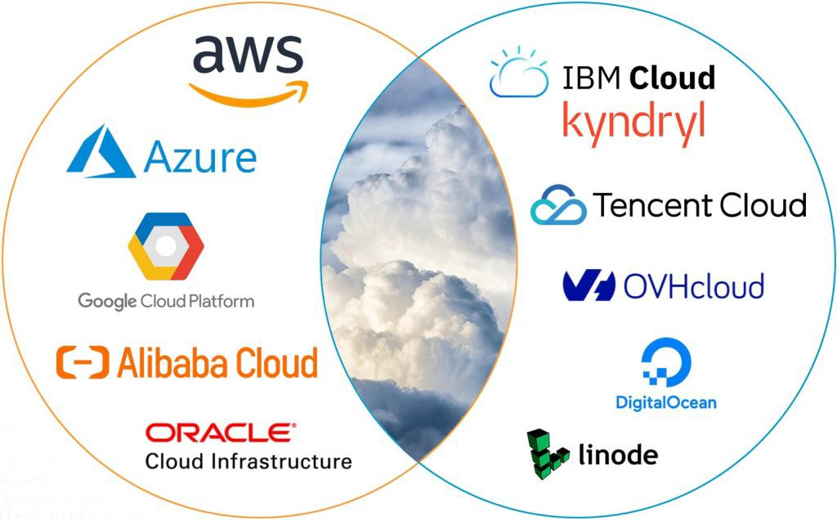
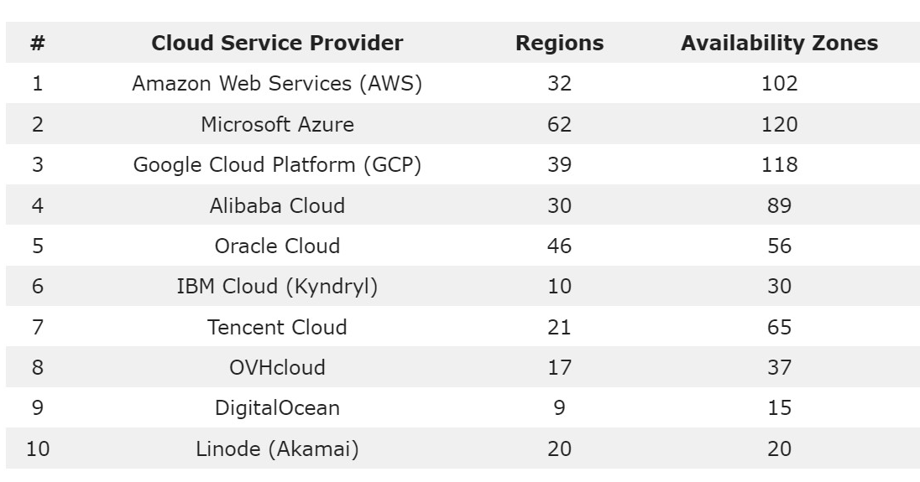
Top 10 Cloud Service Providers
Source: https://dgtlinfra.com/top-cloud-service-providers//

Slide 33
Useful links
Basics of Zoho CRM
https://www.youtube.com/watch?v=x2SuRIFjimI
Microsoft Copilot for Service
https://www.youtube.com/channel/UCJGCg4rB3QSs8y_1FquelBQ

Slide 34
Thank you for your attention!

